Slide 1
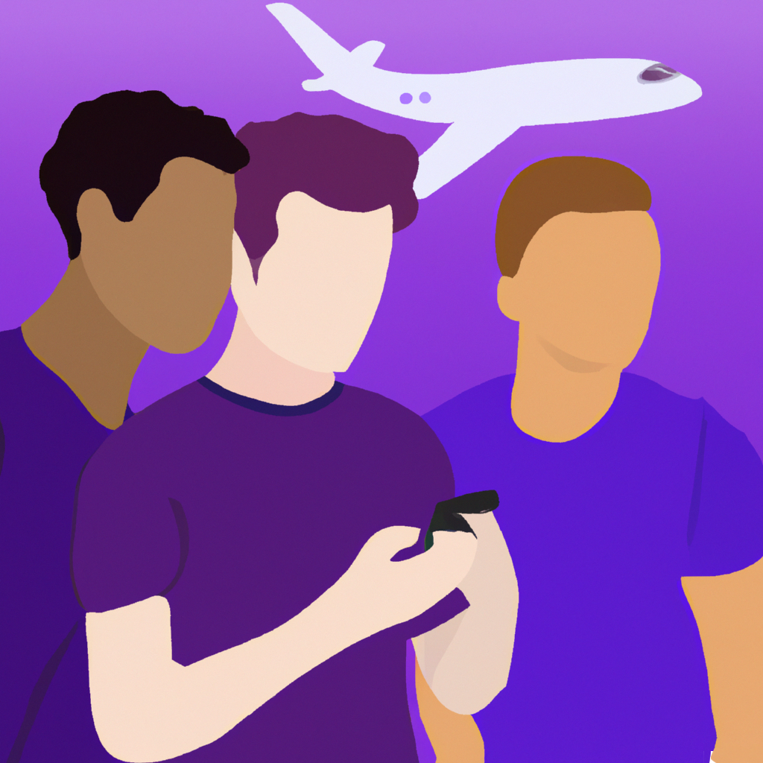
Travel Buds

Slide 2
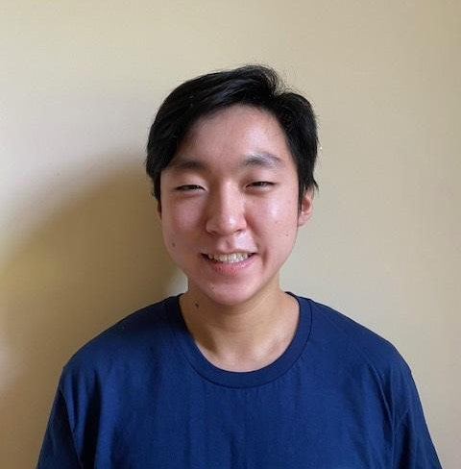
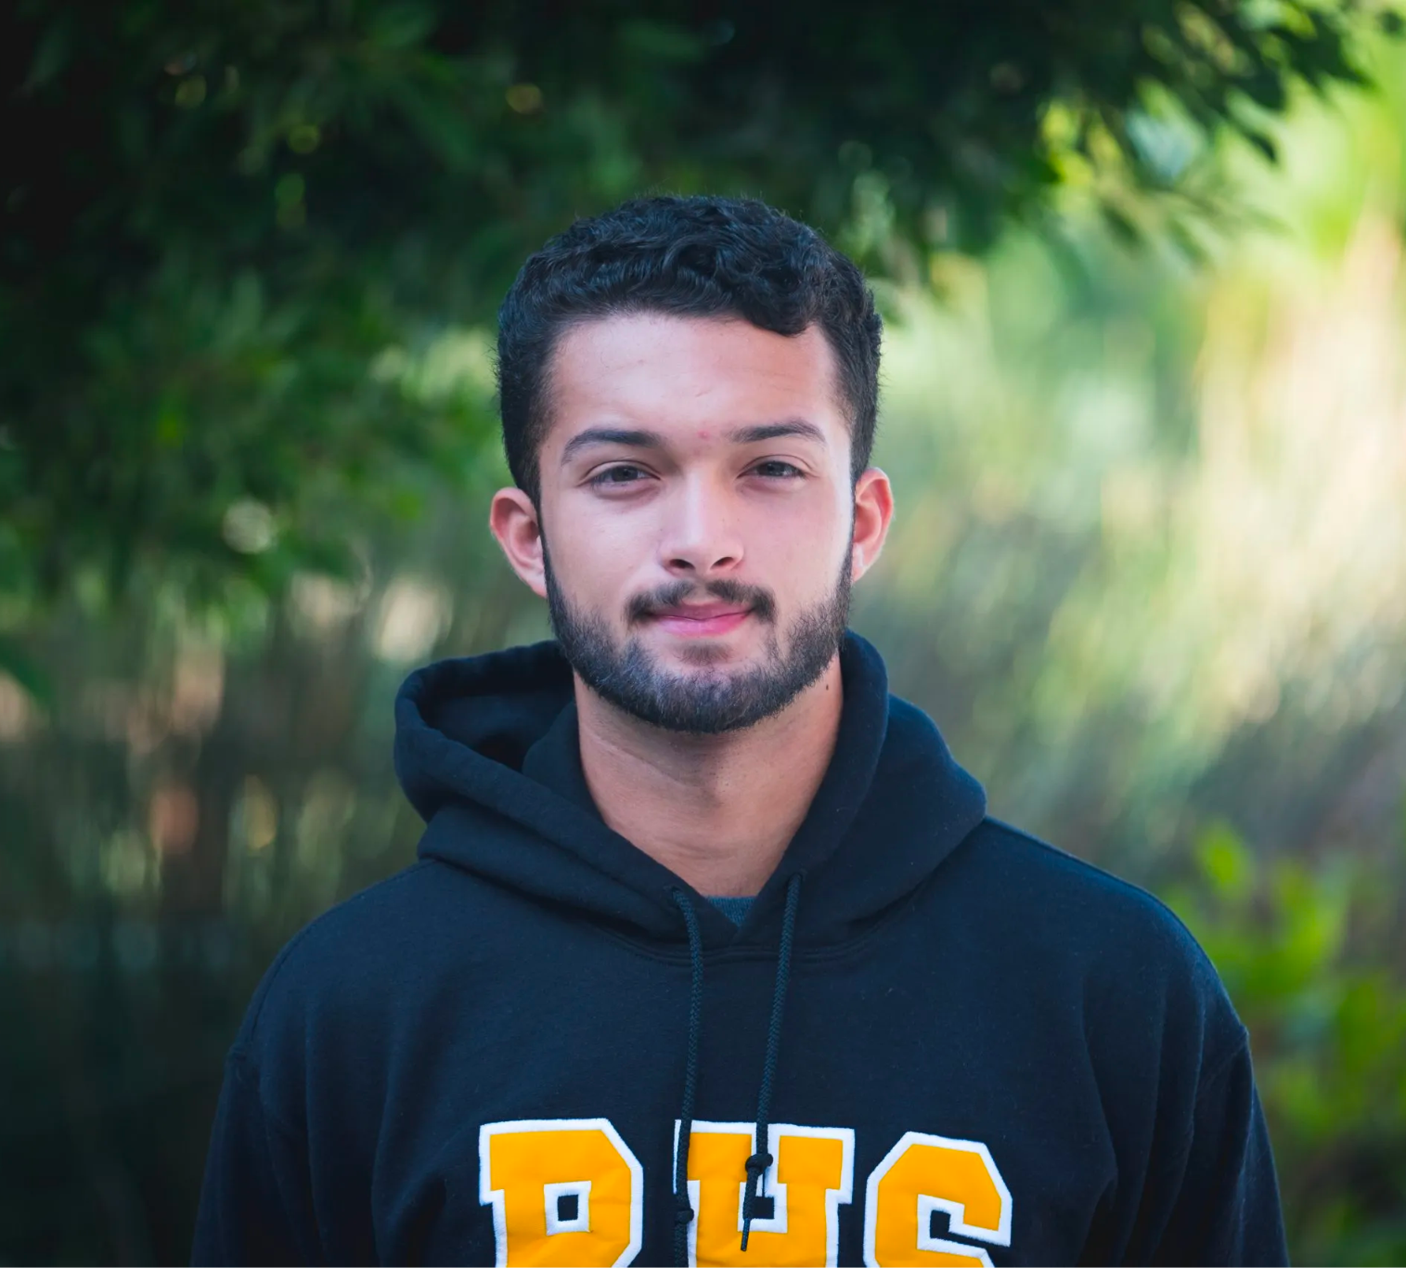


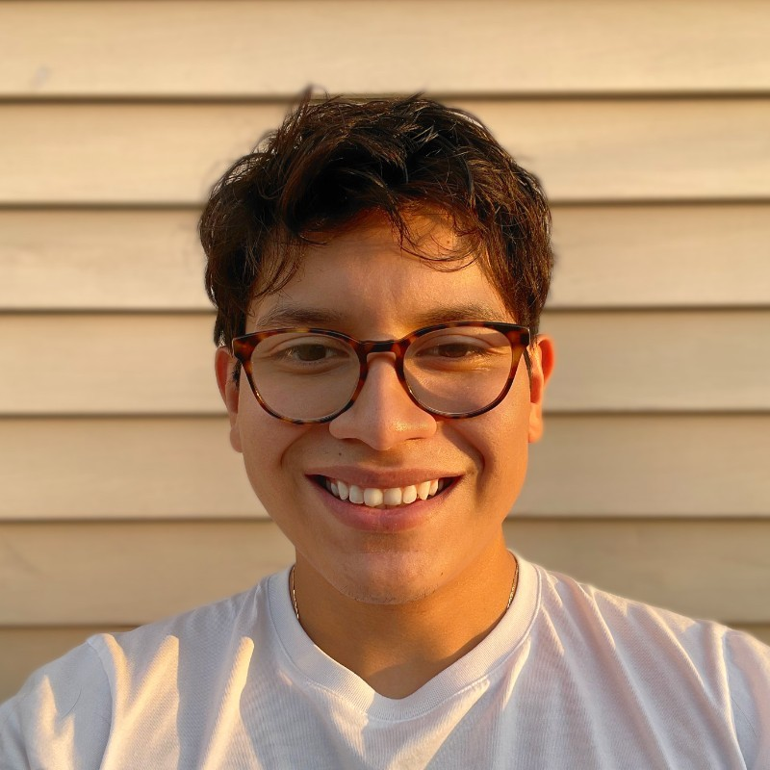
Team Introduction
The Travel Buds team is a motley crew of friends who met in their Sophomore year of college at Schapiro Floor 9 (minus Antonio who joined us the following year at Schapiro Floor 10). We hope you like our app idea and execution :)!
Antonio: Senior in CC / From Chicago! 💨
Brennen: Senior in CC / From Long Island! 🚄
Isaac: Senior in CC / From Los Angeles! 🌮
Yong: Senior in CC / From Hawaii! 🌺
Yuya: Senior in SEAS / From Japan! 🇯🇵

Slide 3
Project Description
Travel Buds is not just a chat app; it's a community that transforms solo travel into a shared adventure. Designed with the passion for exploration in mind, our app connects solo travelers who share common interests, turning every journey into an opportunity for meaningful connections and unforgettable experiences
Key Features
Tailored Matching Algorithm
Real-time chat app
Activity recommendations
Instant translation
Cool badges and icons

Slide 4
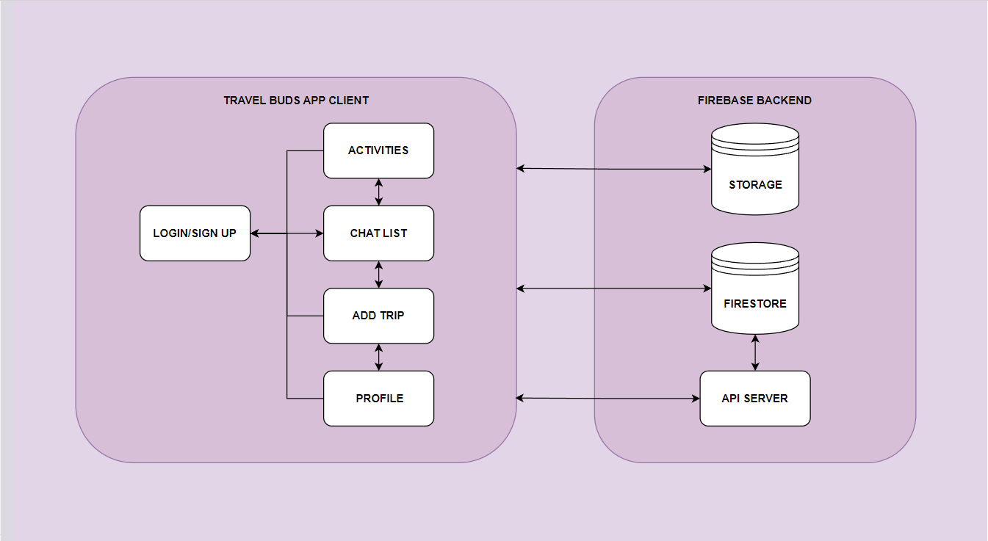
Project Architecture

Slide 5
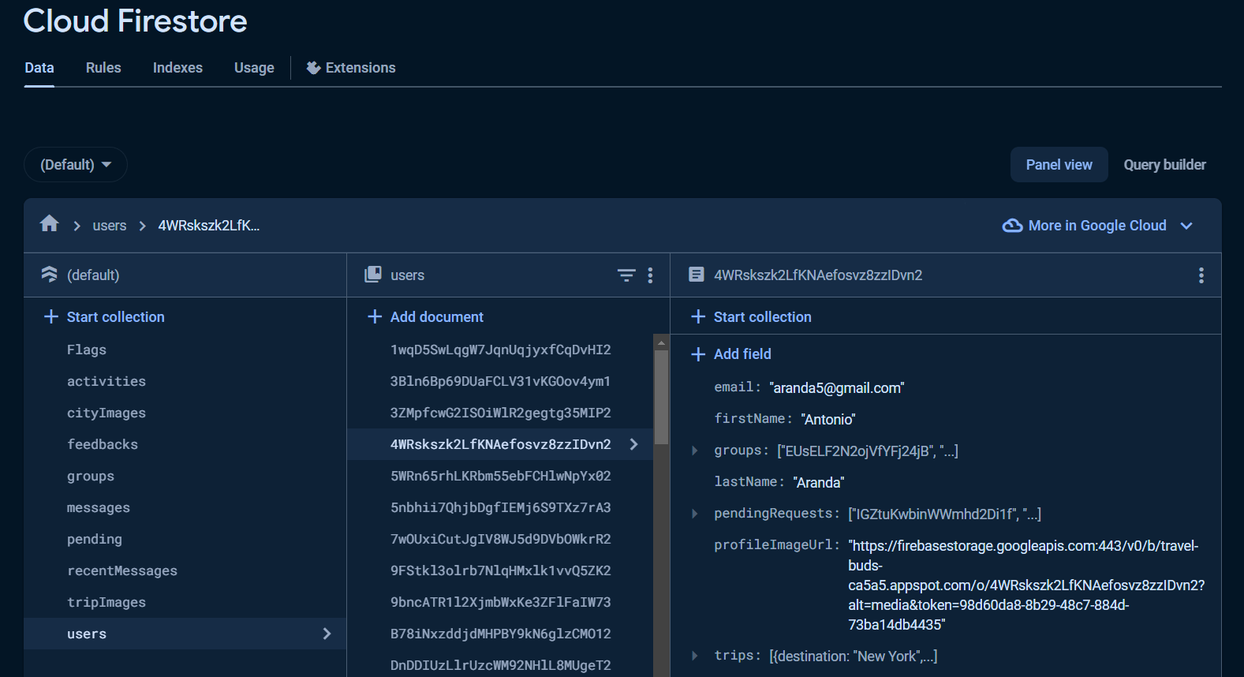
Project Architecture

Slide 6
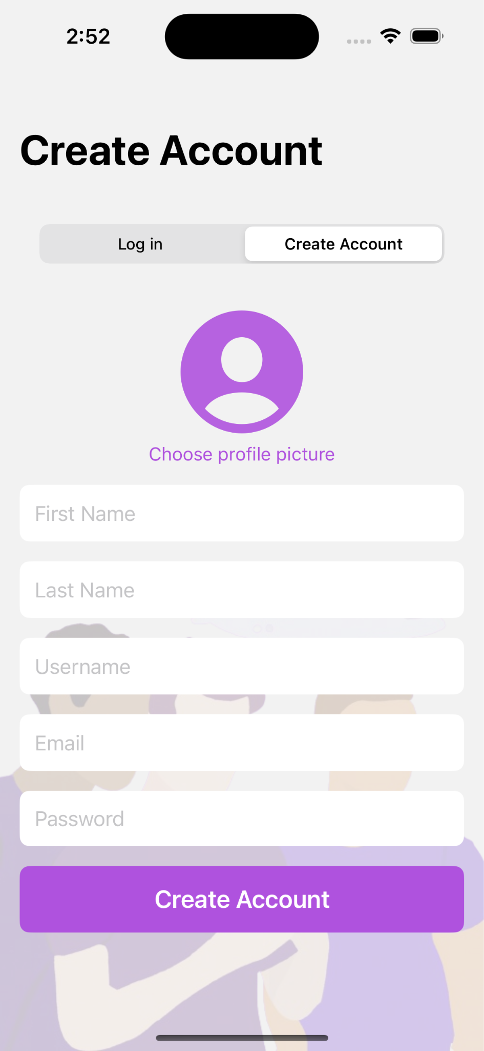
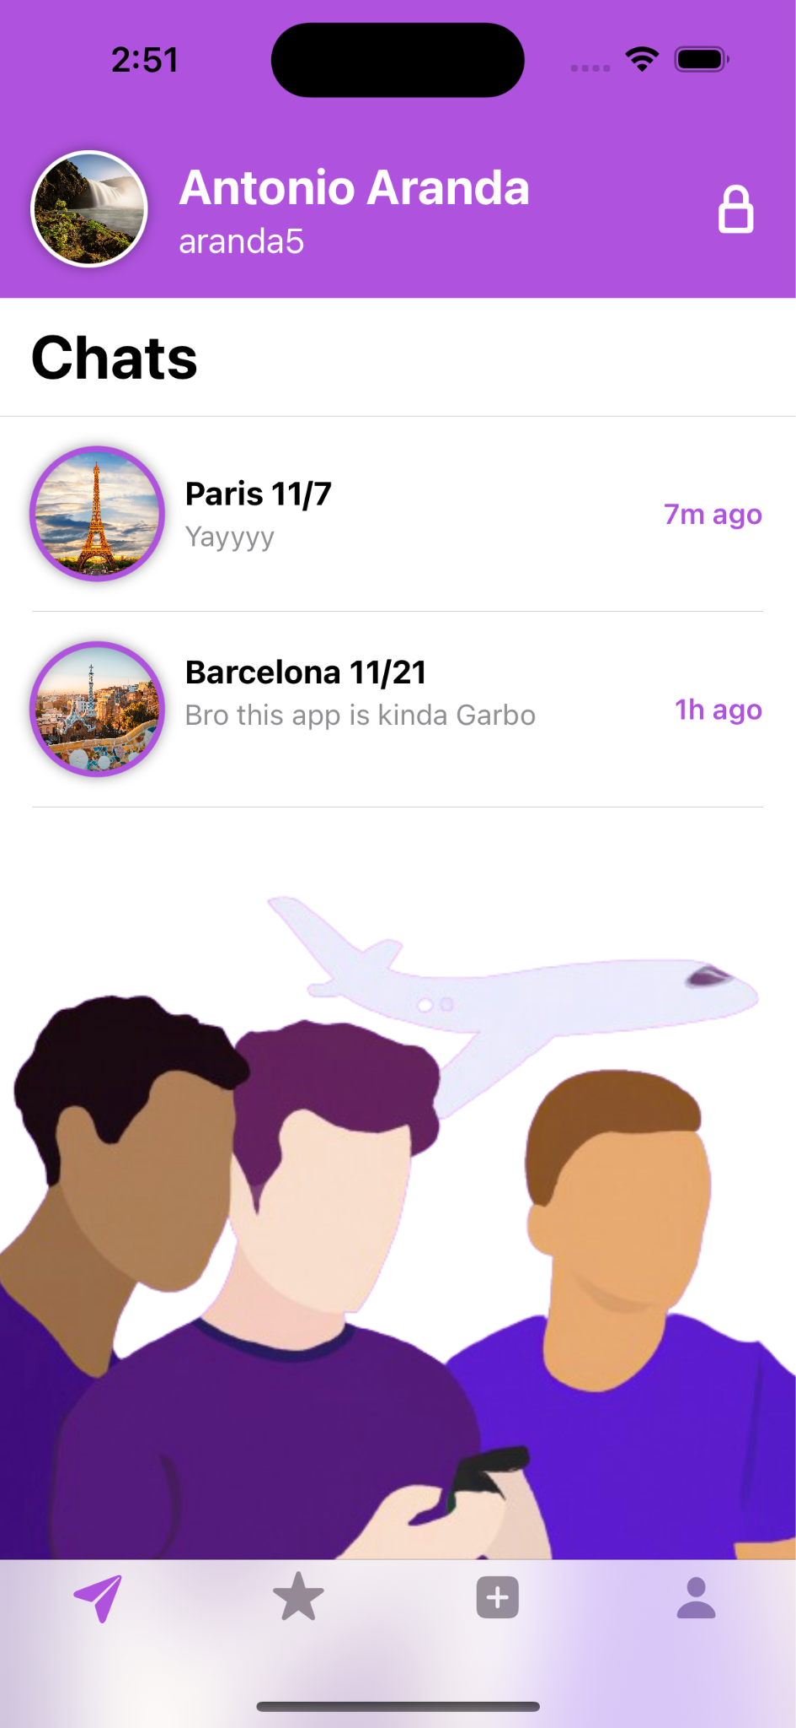
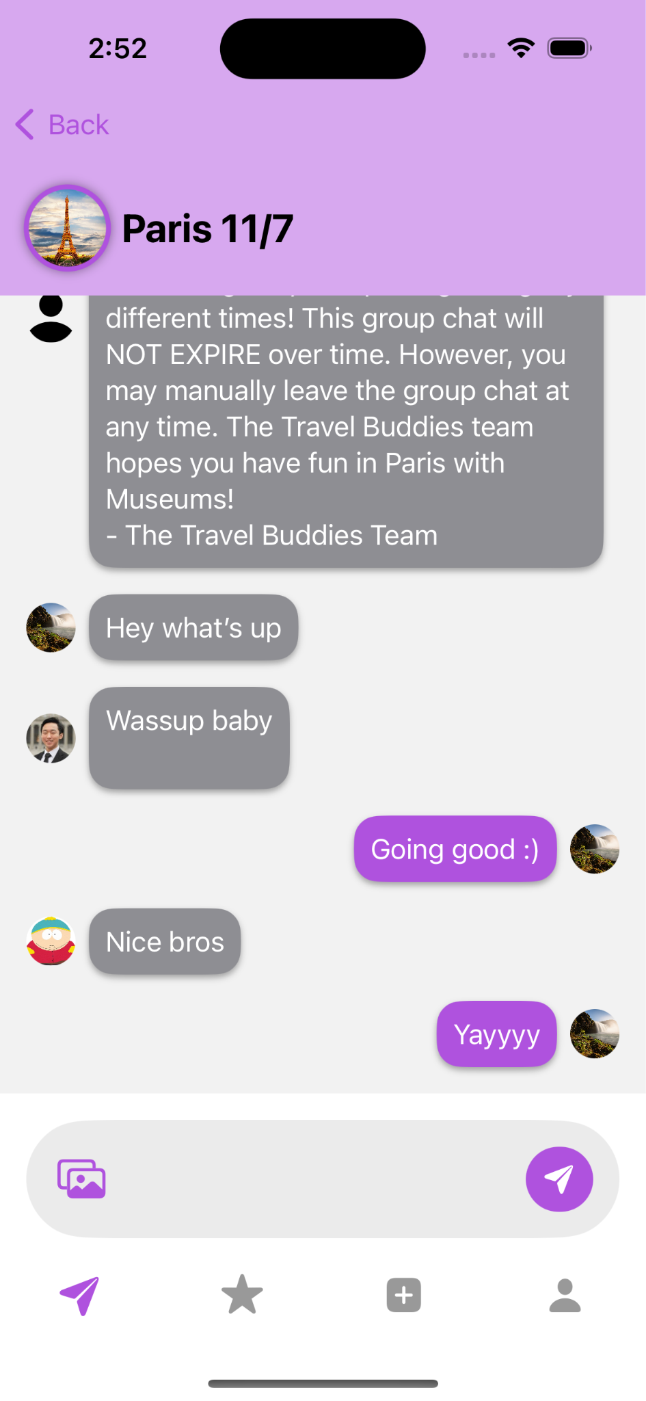
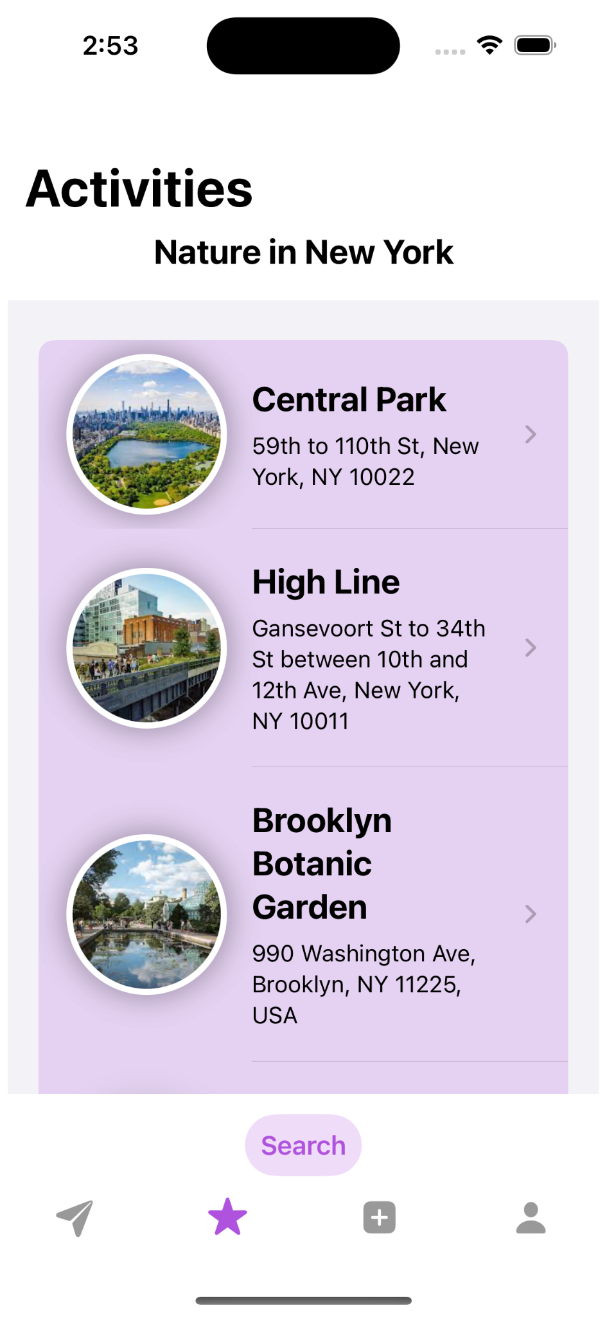
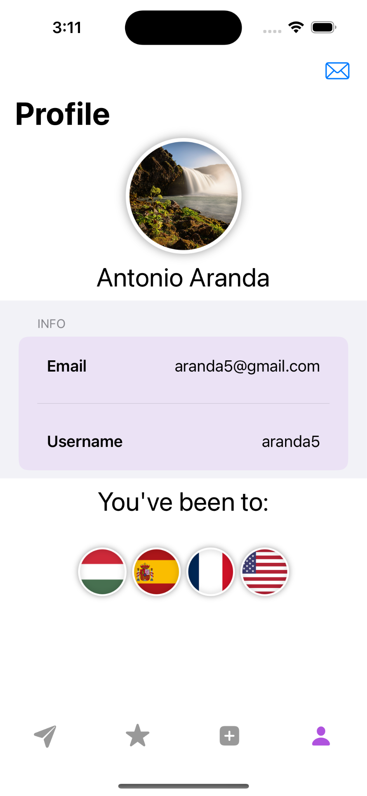
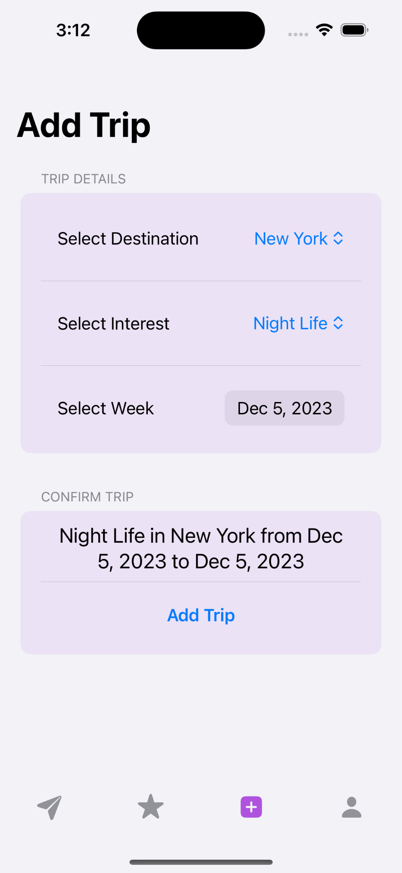
Screenshots

Slide 7

Thank you! 😎👍

